Slide 1

Chapter 6: Call by Value

Slide 2
Pushing Parameters
To push a global parameter:
Use LDA with direct addressing
Then use STA with stack-relative addressing
LDA num,d
STA -2, s

Slide 3
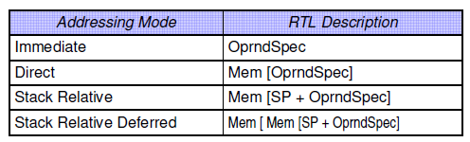
Pushing Parameters onto the Stack
Which addressing method to use depends upon whether:
Variables are Global or Local
Parameters are Call-by-value or Call-by-reference

Slide 4
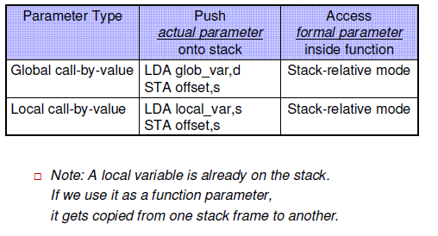
Call-by-Value Parameters

Slide 5
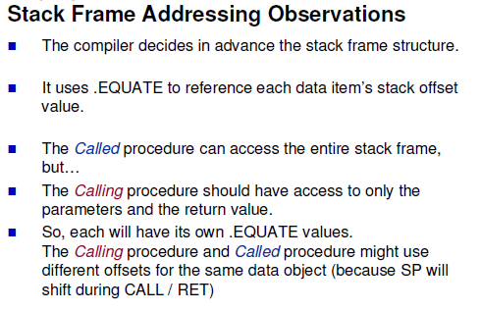
Call-by-Value Parameters

Slide 6
A procedure call with a parameter at Level HOL6 and Level Asmb5: Call be Value with Global Variable Figure 6.21
#include <iostream>
using namespace std;
int numPts;
int value;
int j;
void printBar (int n) {
int k;
for (k = 1; k <= n; k++) {
cout << '*';
}
cout << endl;
}
int main () {
cin >> numPts;
for (j = 1; j <= numPts; j++) {
cin >> value;
printBar (value);
}
return 0;
}

Slide 7
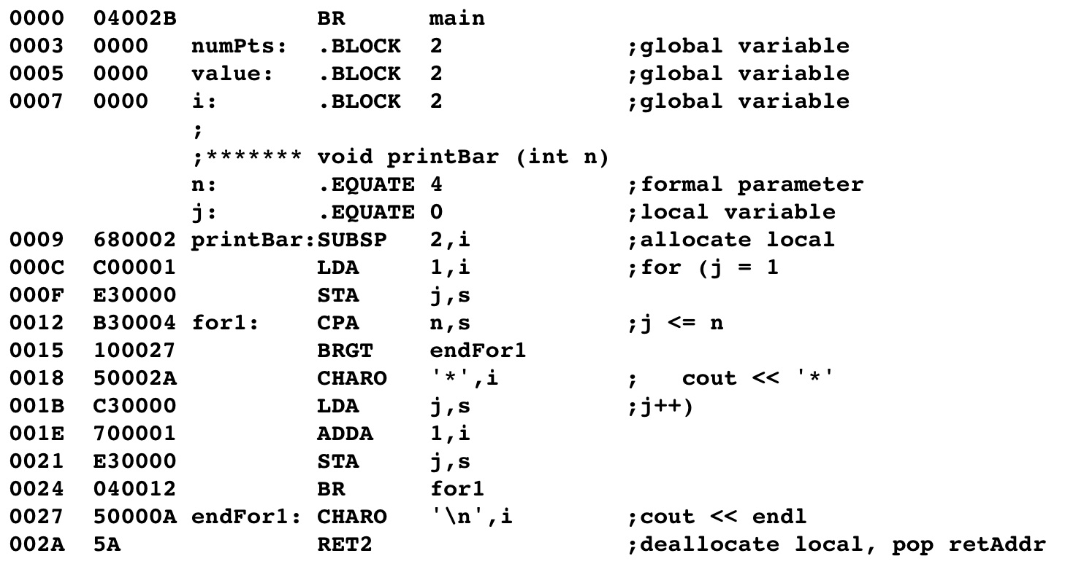
A procedure call with a parameter at Level HOL6 and Level Asmb5 (Cont’d)
Allocate local variable
dellocate local variable and return

Slide 8
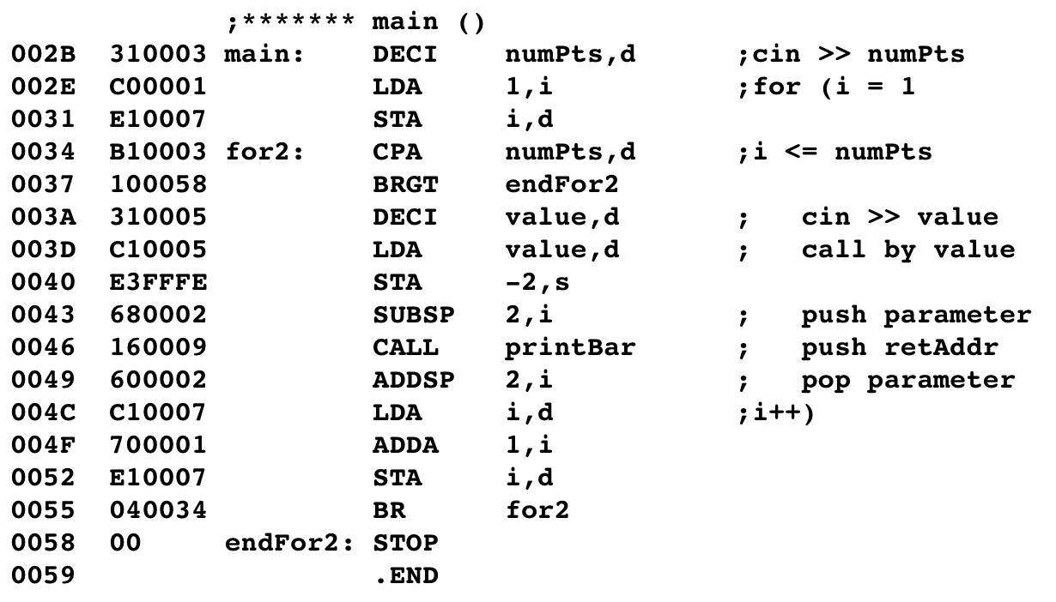
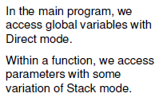
A procedure call with a parameter at Level HOL6 and Level Asmb5 (Cont’d)
Push actual parameter
Pop actual parameter

Slide 9
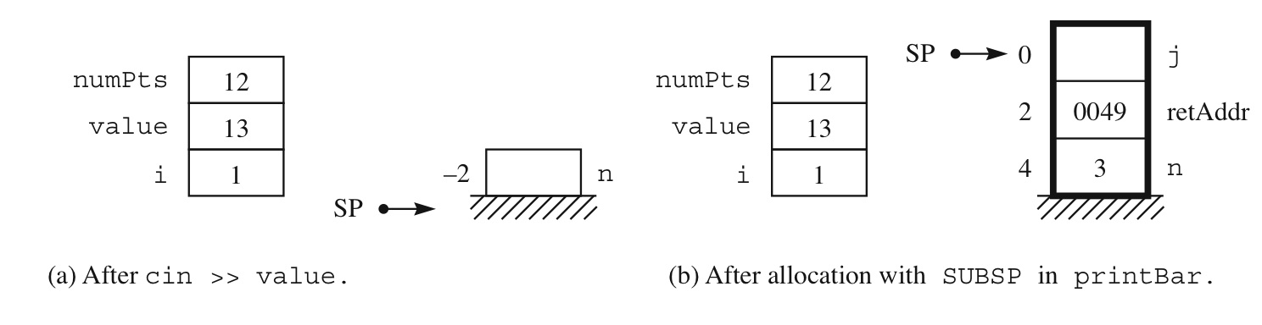
The run-time stack for Program

Slide 10
A function with Call-By-Value parameters and local Variables
Calling:
Push the actual parameters
Push the return address
Called:
Push storage for the local variables

Slide 11
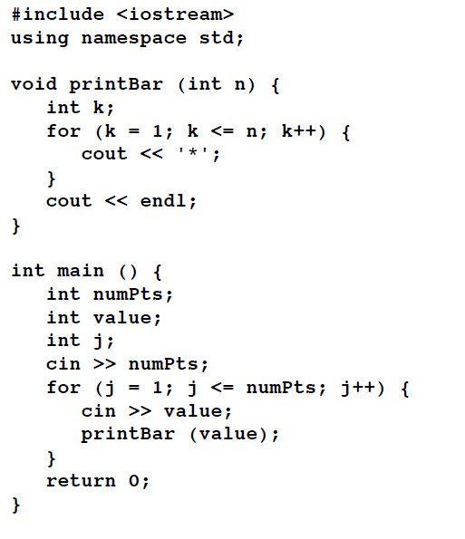
Call-by-value with local variables in main() fig. 6.23

Slide 12
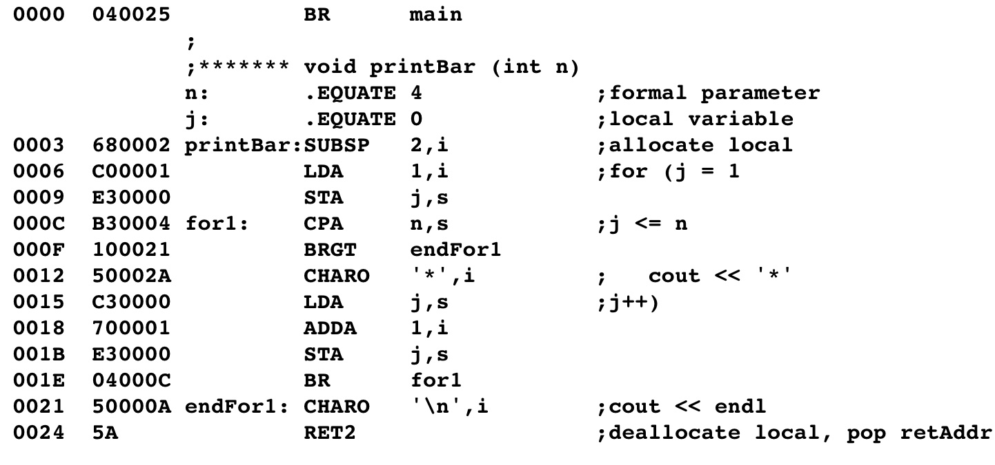
Call-by-value with local variables

Slide 13
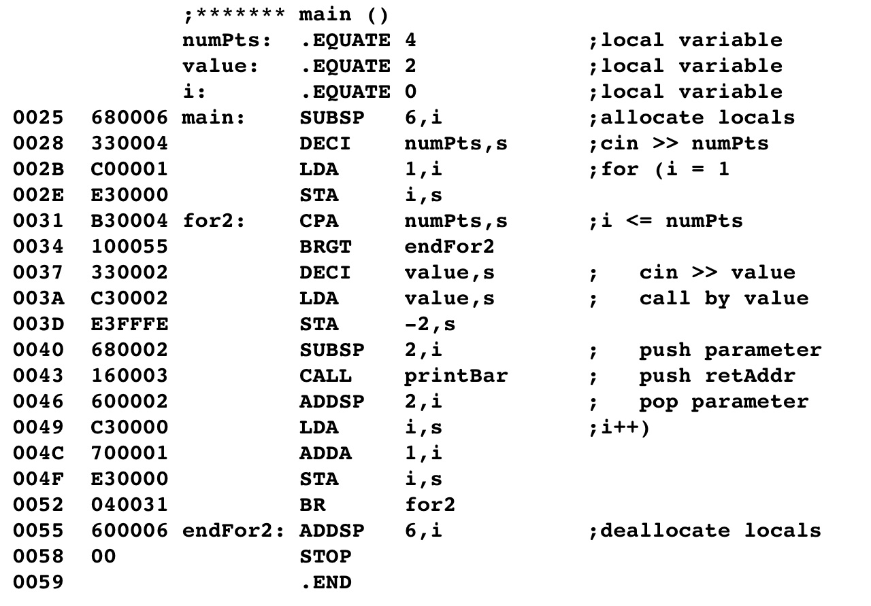
Call-by-value with local variables

Slide 14
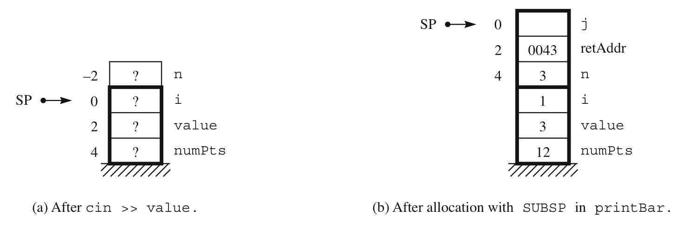
Call-by-value with local variables

Slide 15
A recursive function at Level HOL6 and Level Asmb5
Calling:
Push storage for the returned value
Push the actual parameters
Push the return address
Called:
Push storage for the local variables

Slide 16
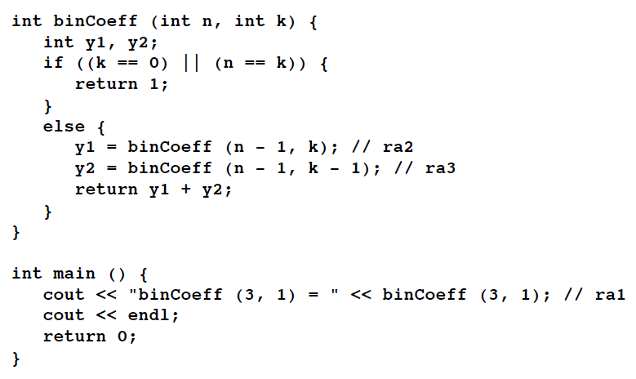
A recursive function at Level HOL6 and Level Asmb5 fig 6.25

Slide 17
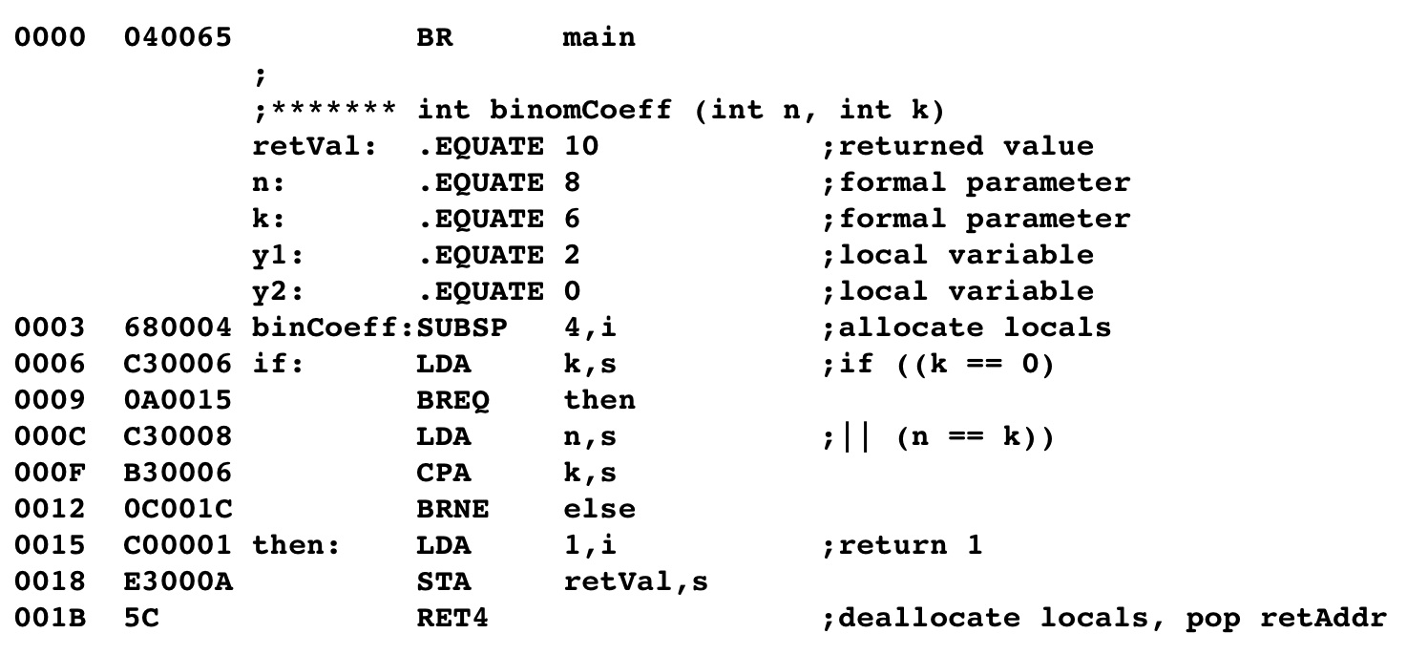
A recursive function at Level HOL6 and Level Asmb5

Slide 18
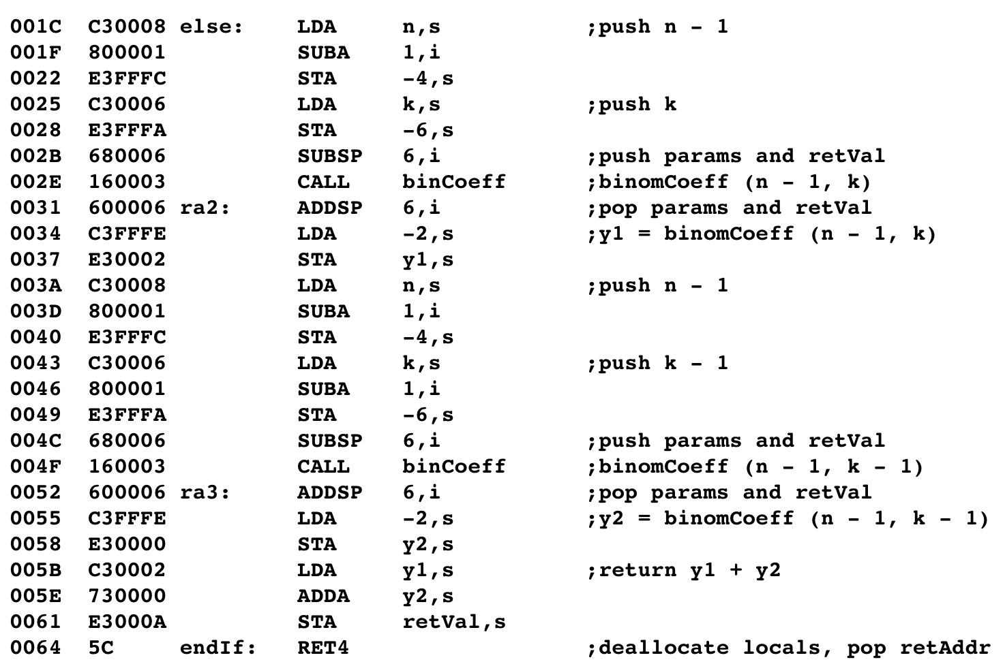
A recursive function at Level HOL6 and Level Asmb5
A recursive function at Level HOL6 and Level Asmb5
First recursive call
same structure as the
subroutine call in main
Pop the stack on return
from subroutine call.
Get the returned value
from previous stack frame
and save on this stack frame.
Second recursive call
same structure as the
subroutine call in main
Pop the stack on return
from subroutine call.
Get the returned value
from previous stack frame
and save on this stack frame.
Pop off local variables
and return (automatically
pops off the return addr).
Add the results and store
in the return value for
this frame stack

Slide 19
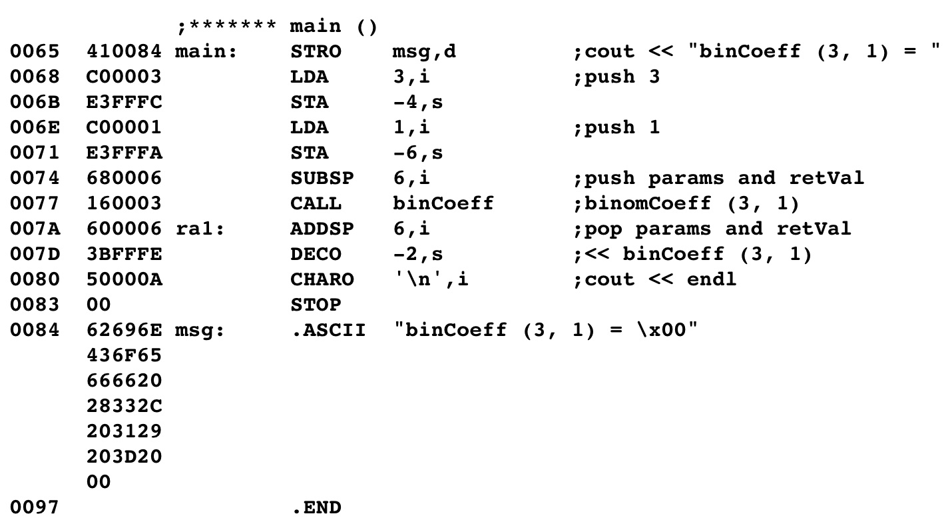
A recursive function at Level HOL6 and Level Asmb5
Store value for first
paramter on the run
time stack
Store value for second
paramter on the run
time stack
Adjust the stack pointer
Jump to subroutine
Automatically pushes
the return address.
On return, must pop off
the parameters and return
value.
Print the returned value.
Note that we can still
access it even though the
SP register has been
modified to pop it off.

Slide 20
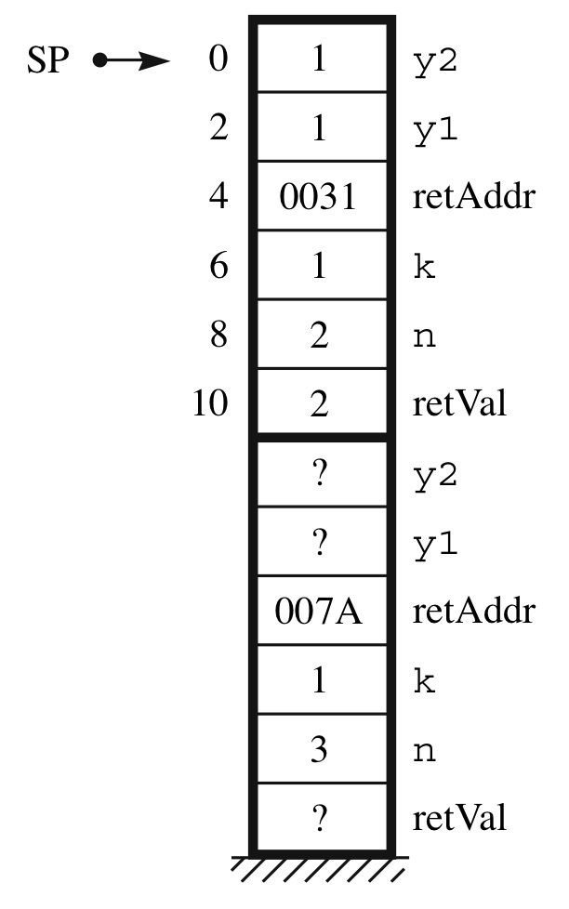
The run-time stack of Program 6.10 immediately after the second return

